Slide 1

Recap
1 : importance of data
2 : our path
3 : data understanding
( Data types, txt , img , speech ,organize & Raw )
4 : Data annotation ( Colum , feature , Dimension , Label )
5 : How a computer see to any data( RGB , Pixel , Channels )
6 :Playgrounds for data labeling
Roboflow :
Bounding boxes
Polygon

Slide 2
Agenda for today
1 : platforms for earning
2 : introduction to GitHub
3 : introduction to google drive
4 : intro to ML

Slide 3
A look on platforms
1 : AUDIO BEE ;
Segmentation platform(for audio labeling)
2 : fiverr ;
Best platform for your skills .
3 : OneForma ;
You can join this platform as a Annotator
4 : Remotask ;
5 : prupoly ;
6 : figure eight ;
7 : up work ;

Slide 4
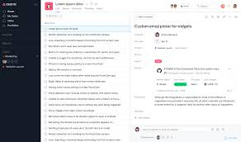
Intro to GitHub
GitHub is a developer platform that allows developers to create, store, manage and share their code. It uses Git software, providing the distributed version control of Git plus access control, bug tracking, software feature requests, task management, continuous integration, and wikis for every project. Wikipedia
Founders: Chris Wanstrath, Scott Chacon, Tom Preston-Werner, P. J. Hyett
Founded: February 2008, San Francisco, California,

Slide 5
Intro to google Doc
Google doc , spread sheet , google drive
Annotation types :
Bounding box , Polygon , ( upper annotation , body , footer
Segmentation :
Segmentation is the process of dividing a company's target market into groups of potential customers
with similar needs and behaviours. Doing so helps the company sell to each customer group using distinct
strategies tailored to their needs.

Slide 6
Intro to machine learning
Machine Learning (ML) encompasses various branches, each focusing on different aspects of data analysis
and predictive modeling. Here are some of the most important branches of ML:
Supervised Learning:
Classification: Predicting discrete labels or categories (e.g., spam detection).
Regression: Predicting continuous values (e.g., house price prediction ,weather predicetion).
Unsupervised Learning:
Clustering: Grouping similar data points together (e.g., customer segmentation).
Dimensionality Reduction: Reducing the number of features while preserving important information (e.g., PCA, t-SNE).
Semi-Supervised Learning:
Combines a small amount of labeled data with a large amount of unlabeled data during training
(e.g., image recognition with limited labeled examples).
Reinforcement Learning:
Learning by interacting with an environment to maximize cumulative reward (e.g., game playing, robotic control).

Slide 7
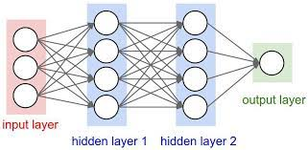
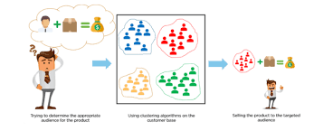
Simple neural network
(ANN)
Prediction module
Regression

Slide 8
Deep Learning:
Deep Learning:
Convolutional Neural Networks (CNNs): Specialized for processing grid-like data, such as images.
Recurrent Neural Networks (RNNs): Specialized for sequential data, such as time series or natural language.
Generative Adversarial Networks (GANs): Consisting of generator and discriminator networks
for generating realistic data (e.g., image generation).
Transfer Learning:
Using pre-trained models on new, but related tasks (e.g., using a model trained on ImageNet for a medical imaging task).
Natural Language Processing (NLP):
Techniques for processing and analyzing human language (e.g., sentiment analysis, machine translation).
Computer Vision:
Techniques for analyzing and interpreting visual data (e.g., object detection, facial recognition).
Anomaly Detection:
Identifying rare or unusual patterns in data (e.g., fraud detection, network security).
Time Series Analysis:
Analyzing data points collected or recorded at specific time intervals (e.g., stock price prediction, weather forecasting).

Slide 9
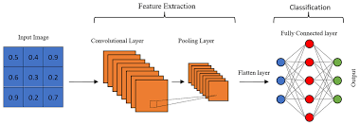
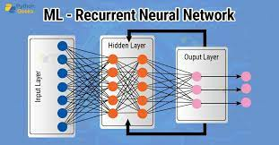
Deep learning modules
Training – testing - validations
CNN
RNN

Slide 10
Home work
1 : 50 img bounding box & polygon(10 per day)
2 : write down your fav skills for fiverr & others
3 : create account on GitHub & put any stuff for public
4 : put your work on google doc and create url

